Slide 1
Design Patterns

Slide 2

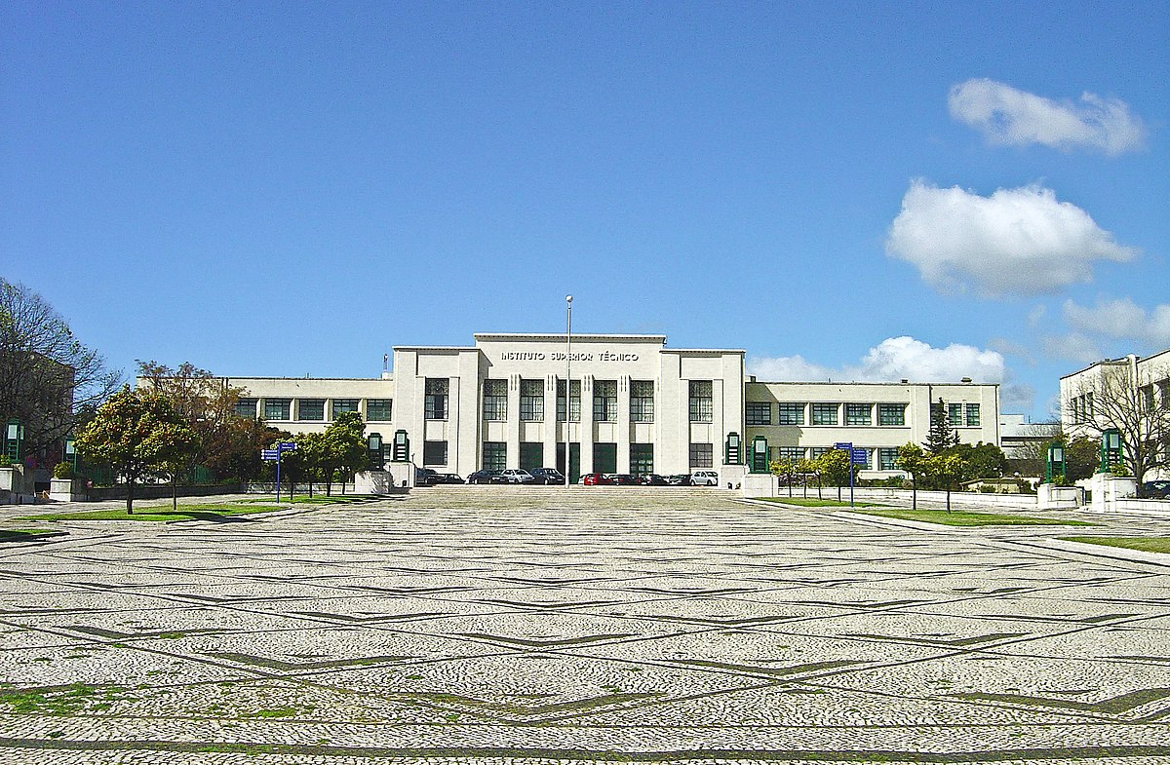



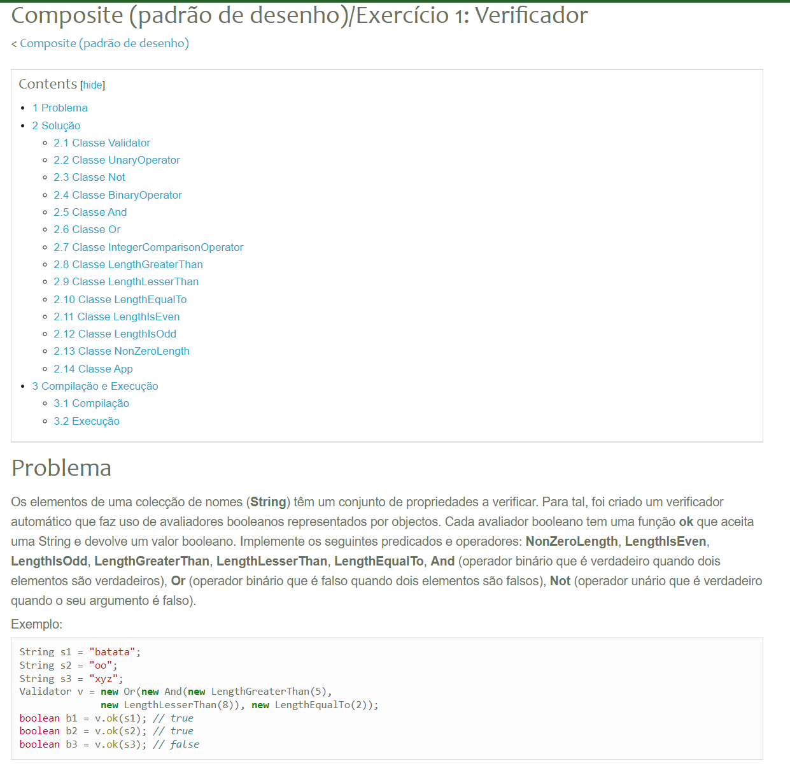

Programação
com
Objetos
Notes:
Since I’ll be teaching Object Oriented Programming next Semester on my home University, I stole some exercises from my head teacher

Slide 3


What are Design Patterns?

Slide 4






What are Design Patterns?
Notes:
They’re elegant solutions to common problems

Slide 5

UML

Slide 6
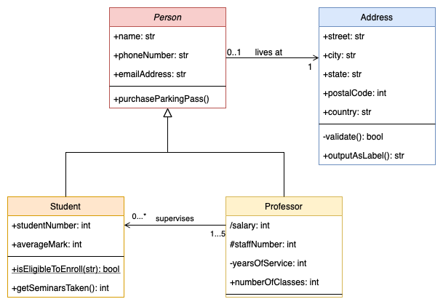
UML Types
Class Diagram

Slide 7
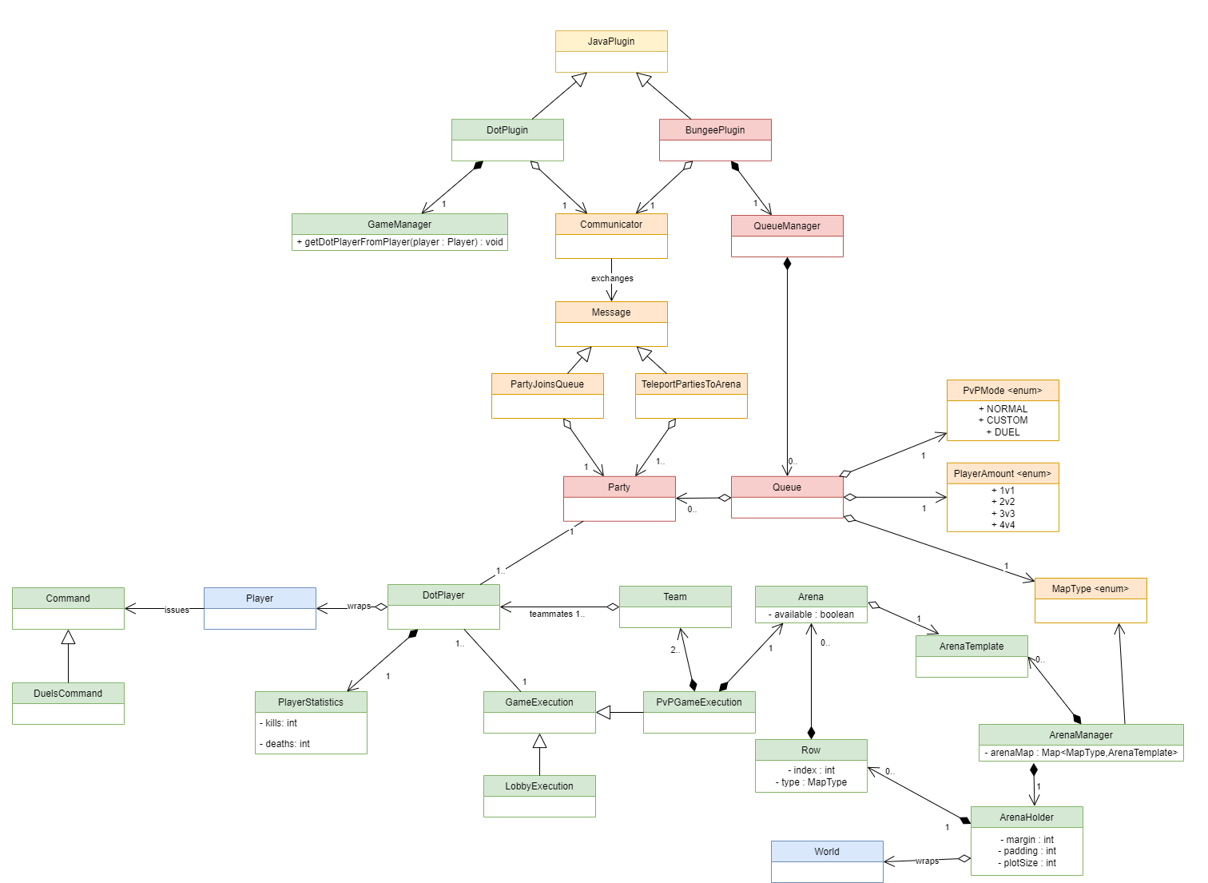
UML Types
Class Diagram

Slide 8
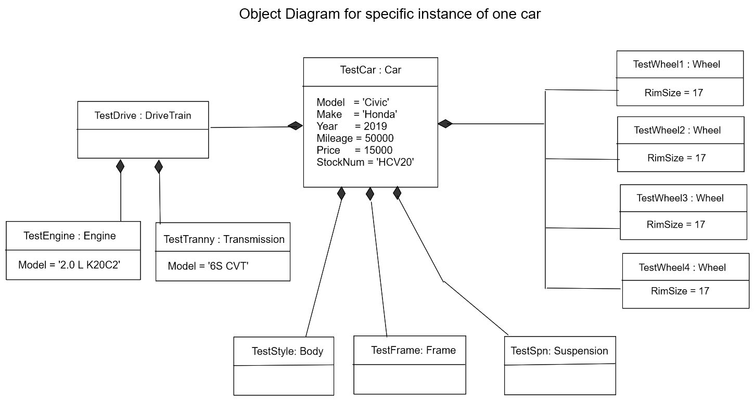
UML Types
Object Diagram

Slide 9



UML Types
Object Diagram
Yoursole: Person
Yourshoe: Person
girlfriend
age = 10
age = 21

Slide 10
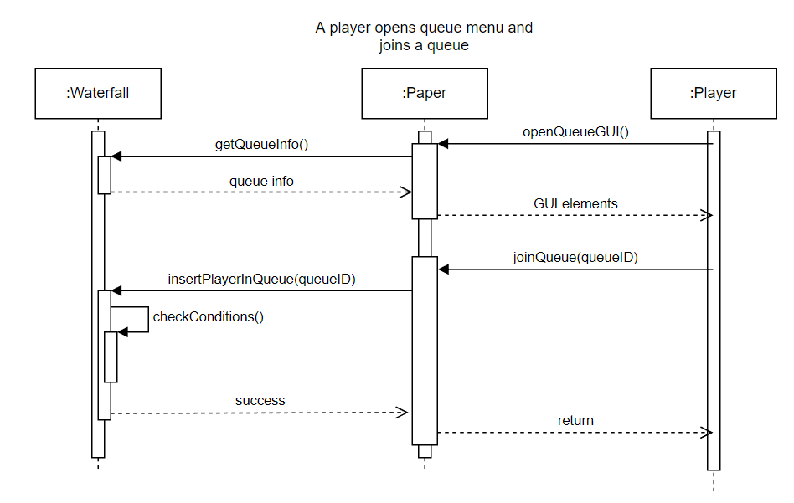
UML Types
Sequence Diagram

Slide 11
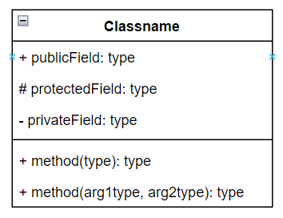
UML Class Diagram
Classes

Slide 12
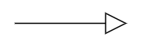
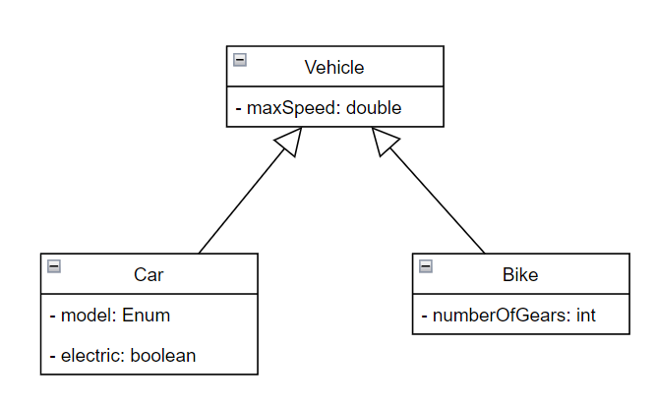
UML Class Diagram
Inheritance (is a)

Slide 13
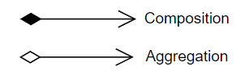
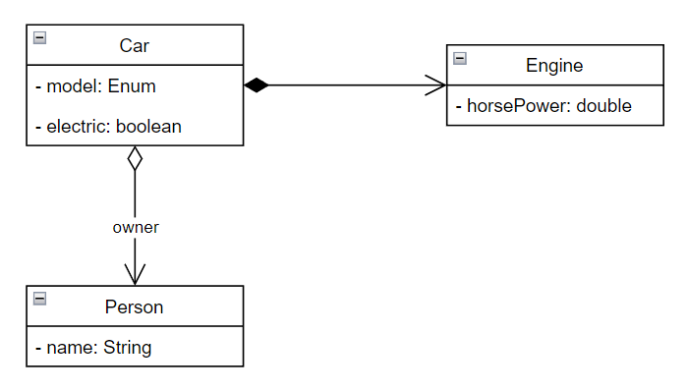
UML Class Diagram
Composition and Aggregation (has a)

Slide 14
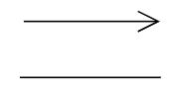
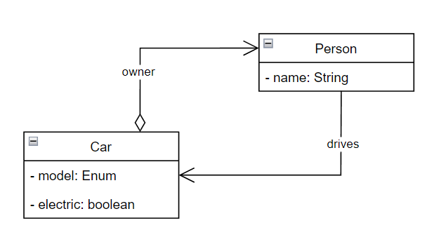
UML Class Diagram
Association

Slide 15
Patterns: Composite
Motivation
Topic3/src/Examples/Composite/TaxPayer

Slide 16
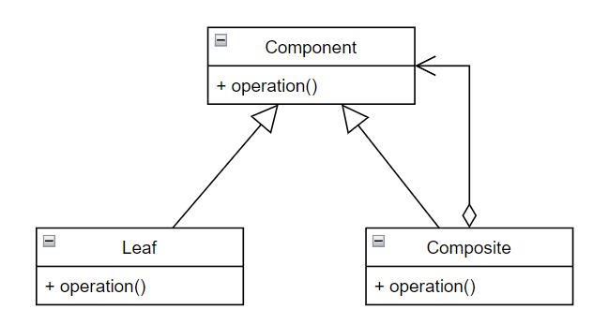
Patterns: Composite
For each component:
component.operation();

Slide 17
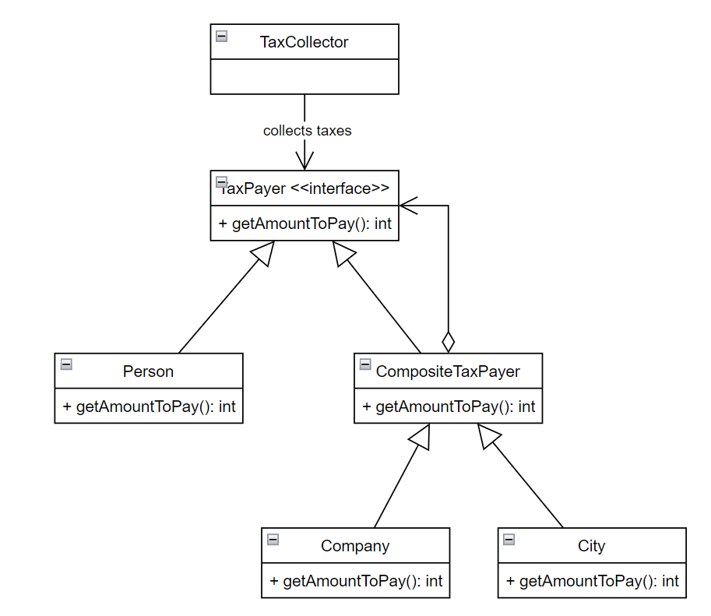
Patterns: Composite

Slide 18
Patterns: Composite
Exercise
Topic3/src/Exercises/Composite/StringVerifier

Slide 19
Patterns: Singleton
Motivation
Problem: How can I ensure that a given class can only have 1 instance?
Why?:
Some instances are very expensive to create (ex: Database connections)
Global access point to the instance

Slide 20
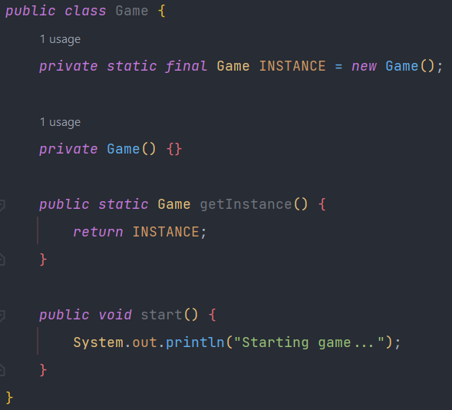
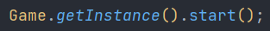
Patterns: Singleton

Slide 21
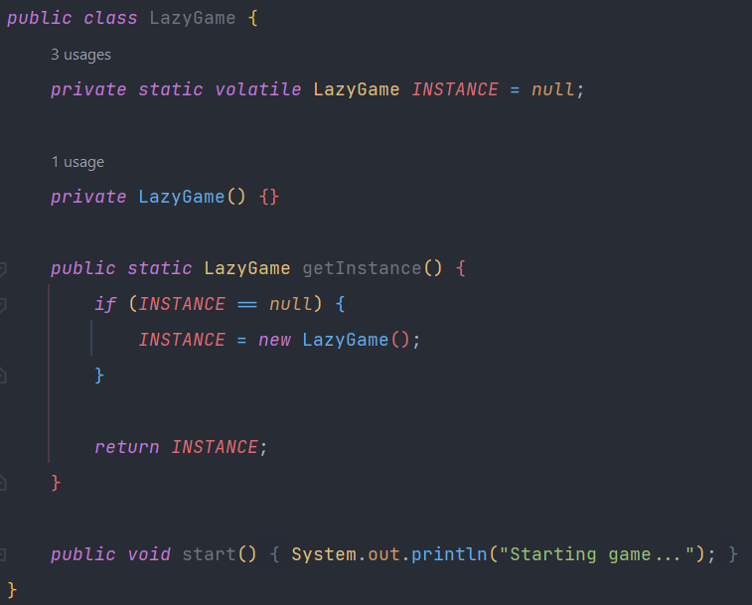
Patterns: Singleton
Notes:
Lazy initialization

Slide 22
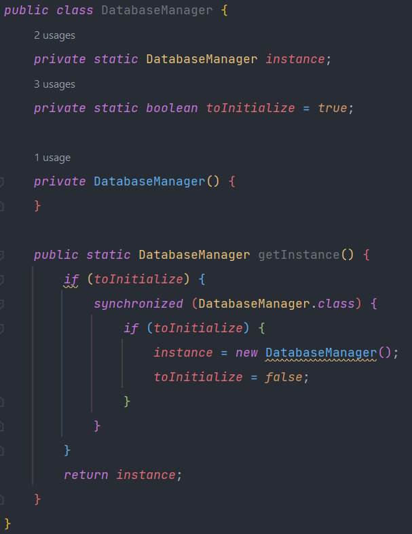
Patterns: Singleton

Slide 23

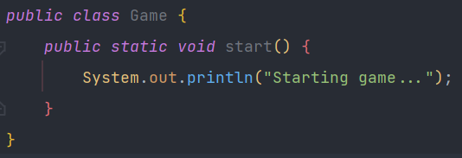



Patterns: Singleton
Less code
Compatible with inheritance
Customizable lazy initialization
Restrict the number of instances (not just to 1)

Slide 24


Patterns: Decorator (aka Wrapper)
NOT RAPPER
Motivation
Topic3/src/Examples/Decorator/Printer

Slide 25
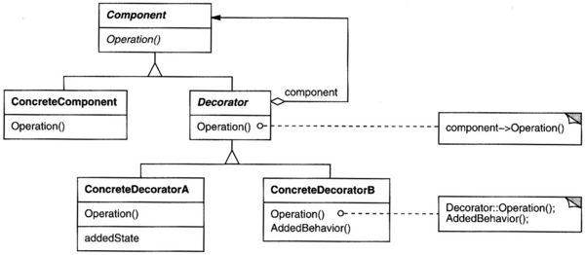
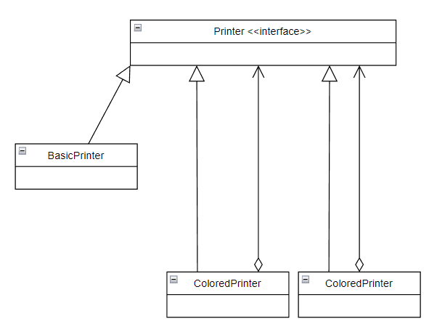
Patterns: Decorator

Slide 26
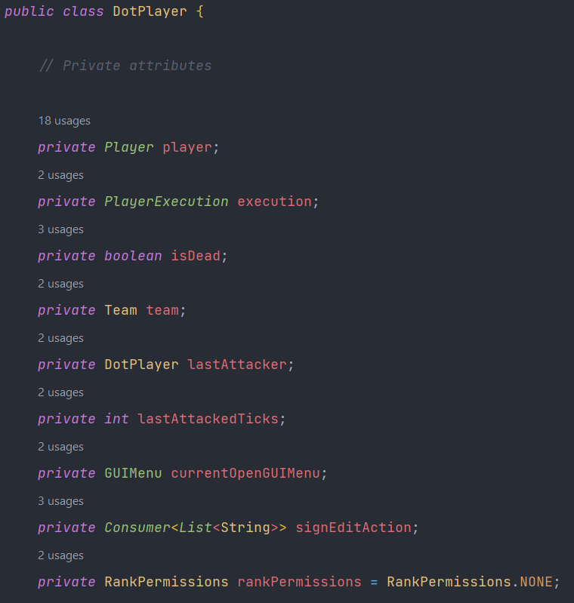
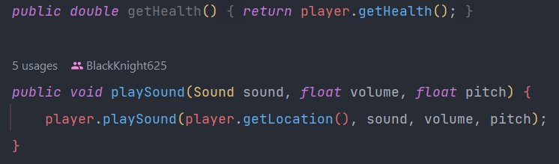
Patterns: Decorator
Minecraft Example
DotPlayer is wrapping Bukkit’s Player
Notes:
Bukkit Players come from a Library, whose code cannot be modified. If we want to add extra functionality to players, we need to use a Decorator

Slide 27
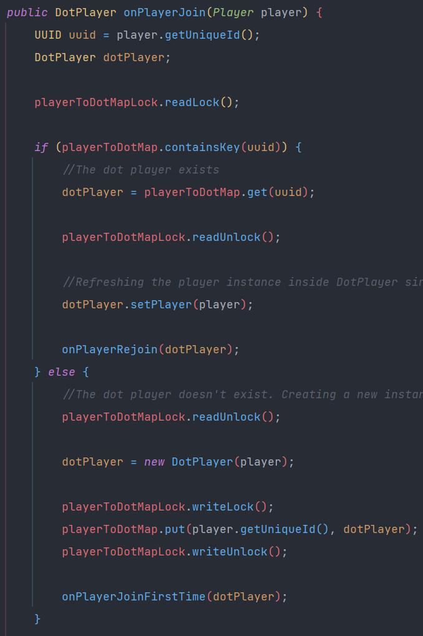
Patterns: Decorator
Minecraft Example

Slide 28
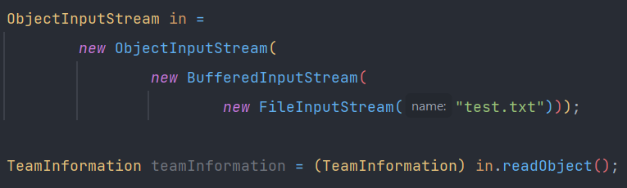
Patterns: Decorator
Java Built-in Example

Slide 29
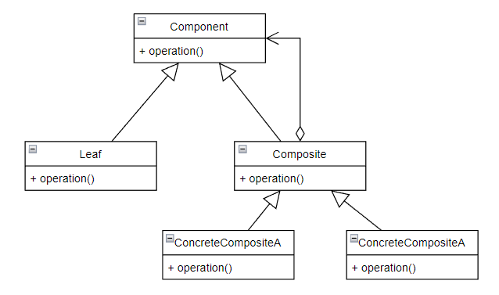
Patterns: Decorator
Differences with Composite
Decorator
Composite
Notes:
Composite subclasses don’t add new behavior (new methods). Their only added state is usually just a Collection of components. The Decorator usually only wraps a single component.

Slide 30
Patterns: Decorator
Exercise
Topic3/src/Exercises/Decorator/TextFormat
Very similar to Bungee TextComponent

Slide 31

Patterns: State
Motivation- Example: Semaphores
When the semaphore’s clock ticks, it should transition from green -> yellow, yellow -> red, red -> green.
There’s a panic button that when pressed makes the semaphore turn red and ignore clock ticks.
The ‘off’ button makes the semaphore’s yellow light blink (unless in panic mode).
The ‘on’ button is the only way to transition from ‘blinking’ or ‘panic’ to a normal function again, turning the semaphore red.
People may only cross if the semaphore’s light is red or is blinking yellow (carefully).
Cars may only cross if the light is green, yellow or blinking yellow (carefully).
When created, the semaphore is blinking yellow.

Slide 32
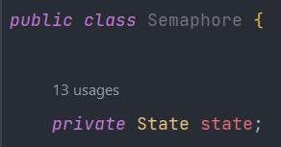
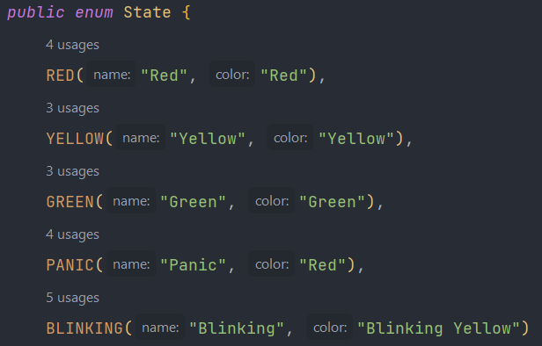
Patterns: State
Motivation- Example: Semaphores Naive Implementation

Slide 33
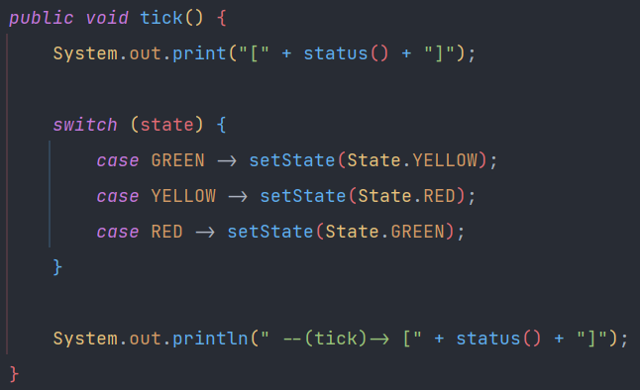
Patterns: State
Motivation- Example: Semaphores
When the semaphore’s clock ticks, it should transition from green -> yellow, yellow -> red, red -> green.

Slide 34

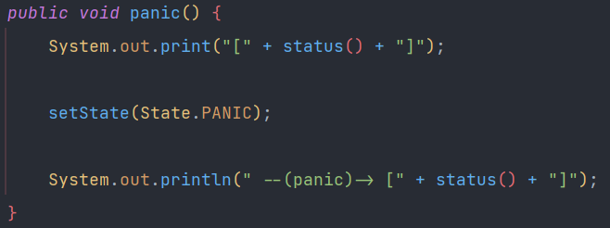
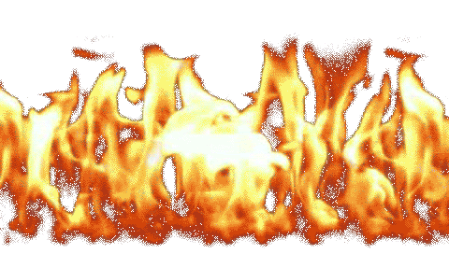
Patterns: State
Motivation- Example: Semaphores
There’s a panic button that when pressed makes the semaphore turn red and ignore clock ticks.

Slide 35
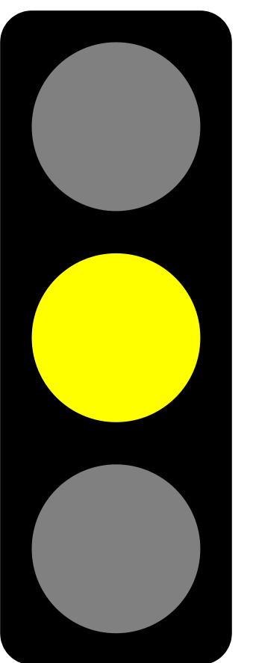
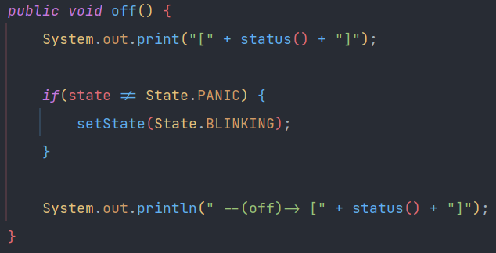
Patterns: State
Motivation- Example: Semaphores
The ‘off’ button makes the semaphore’s yellow light blink (unless in panic mode).
*pretend that it’s blinking*

Slide 36
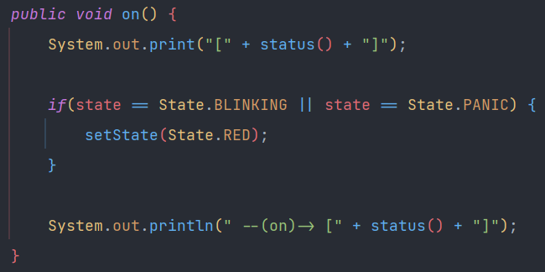
Patterns: State
Motivation- Example: Semaphores
The ‘on’ button is the only way to transition from ‘blinking’ or ‘panic’ to a normal function again, turning the semaphore red.

Slide 37
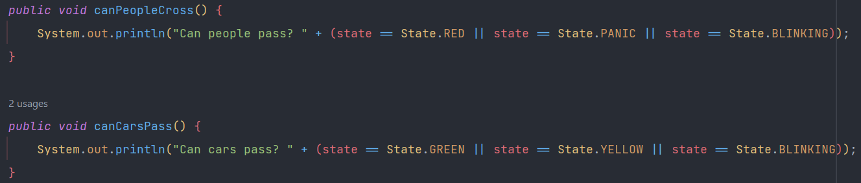



Patterns: State
Motivation- Example: Semaphores
Cars may only cross if the light is green, yellow or blinking yellow (carefully).
When created, the semaphore is blinking yellow.

Slide 38
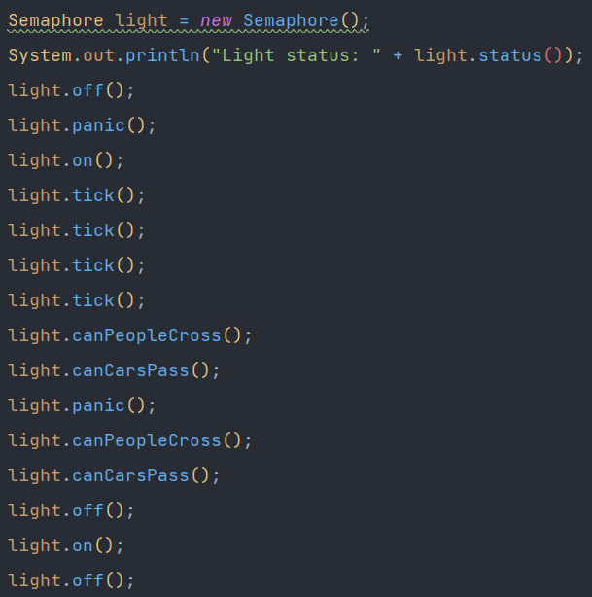
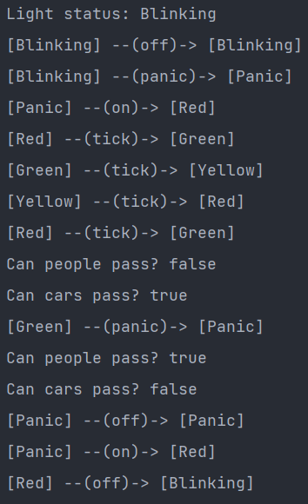
Patterns: State
Motivation- Example: Semaphores

Slide 39

Patterns: State
Does this look good?
Notes:
No! Changing the current state to a new state purely depends on the current state. We should give the State class more control

Slide 40
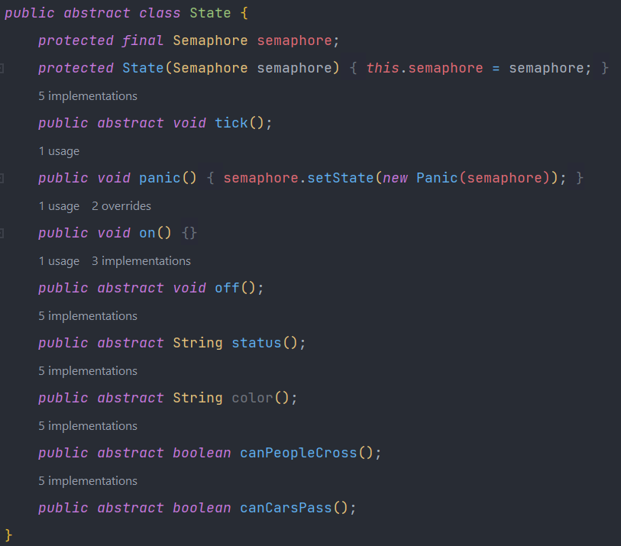
Patterns: State

Slide 41
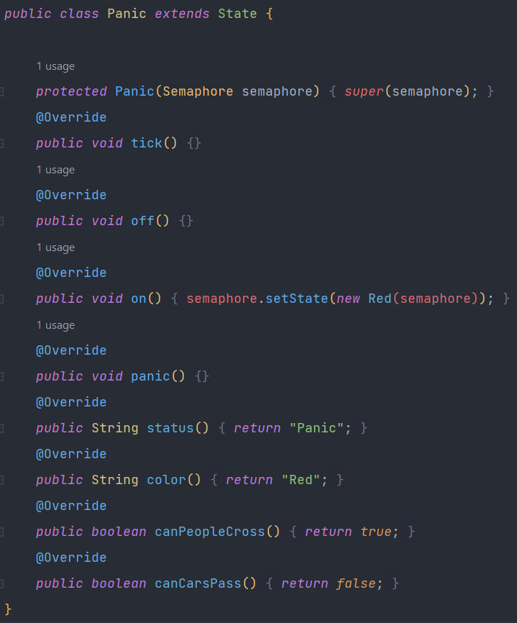
Patterns: State

Slide 42
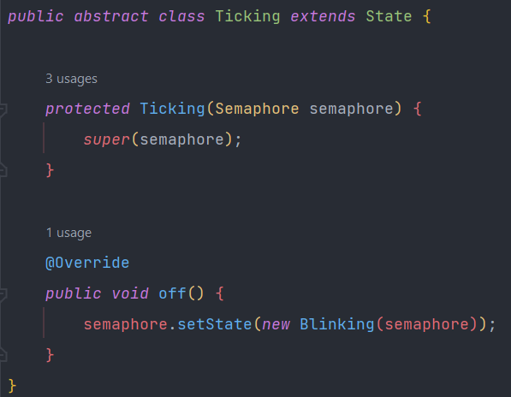
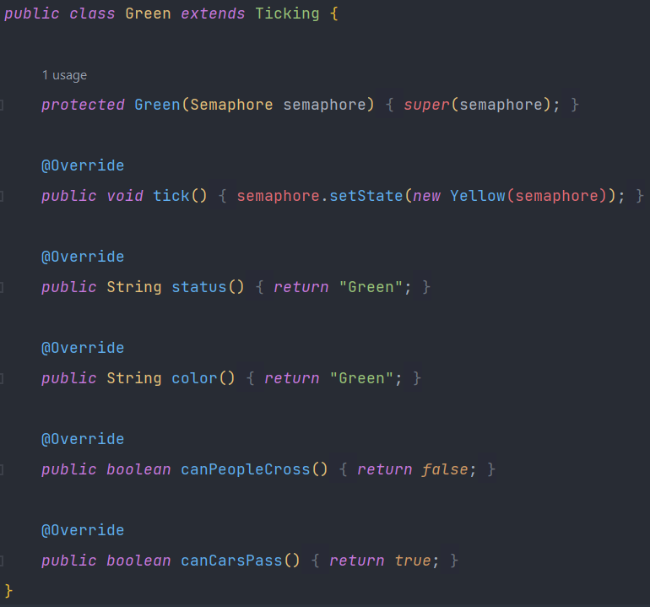
Patterns: State

Slide 43
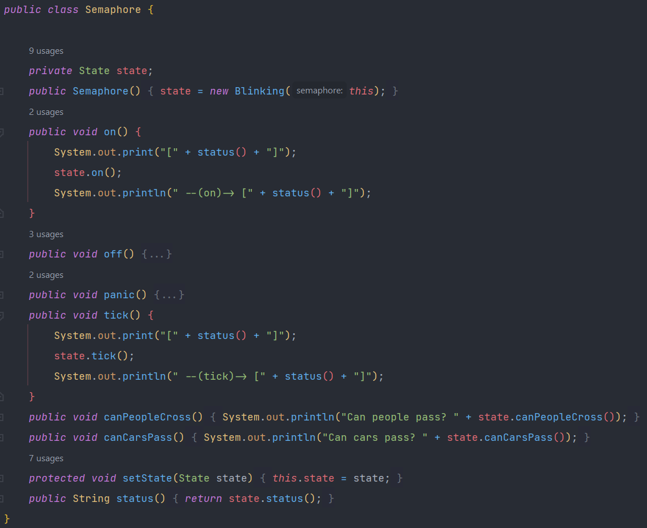
Patterns: State

Slide 44
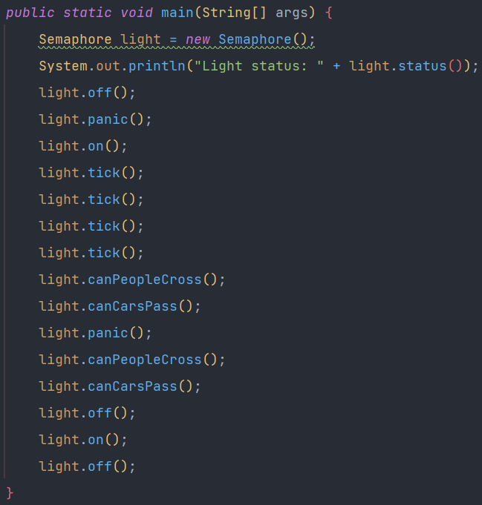
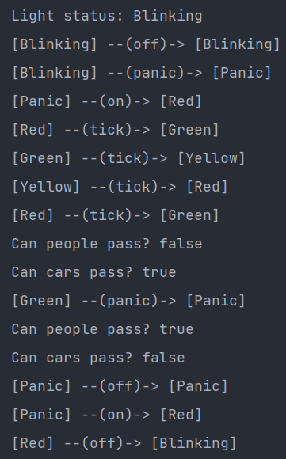
Patterns: State
Notes:
No refactoring is needed elsewhere. The main method stays the same

Slide 45
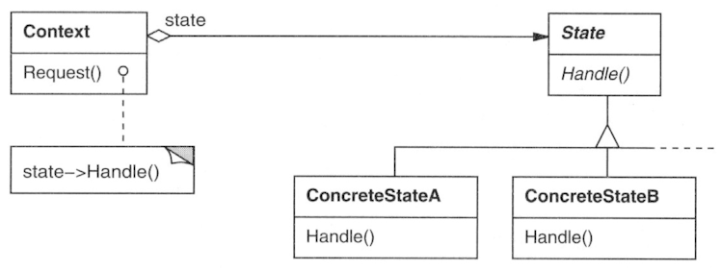
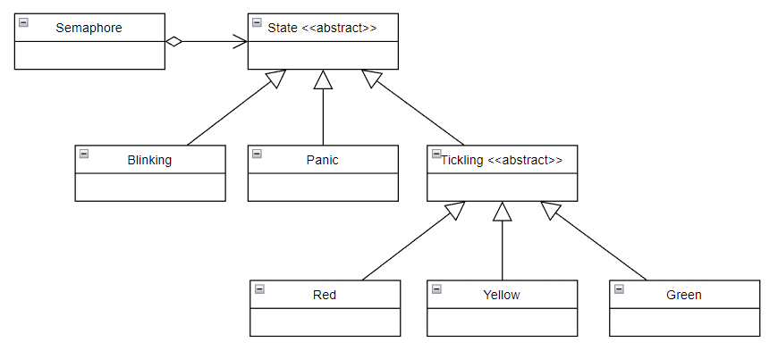
Patterns: State

Slide 46

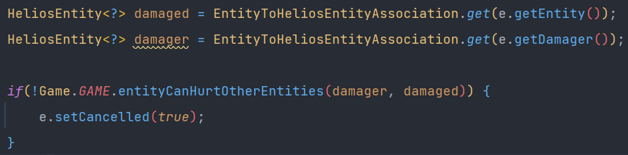
Patterns: State
Example: Heliomothra Game Stages
Game States:
Lobby
Preparation
Middle
Pre-lobby
Deathmatch
End
Can you identify the Design Patterns used here?
Decorator
Fetching the object that’s wrapping the damager
Singleton

Slide 47
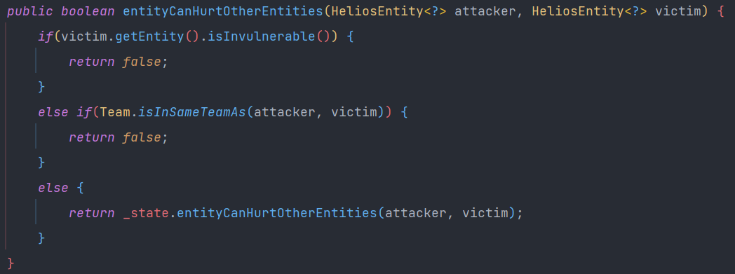
Patterns: State
Example: Heliomothra Game Stages
Game States:
Lobby
Preparation
Middle
Pre-lobby
Deathmatch
End
Checks if both entities inside Arena
false
Players can hurt non-player entities
true
true
false

Slide 48
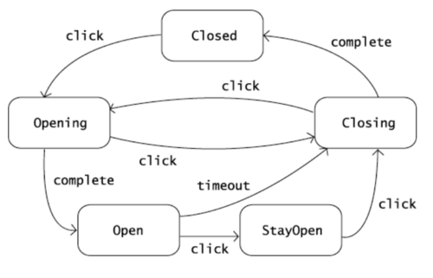
Patterns: State
Exercise
Topic3/src/Exercises/State/AutomaticDoor
In this picture, you may find the door’s possible states.
The states transition to each-other if and only if the specified stimulus are applied.
The stimulus are:
Click (open/close button),
Complete (end of opening/closing cycle),
Timeout (too much time has passed in a specific state).

Slide 49


Patterns: Strategy
Strategy
State
Notes:
Strategy is more algorithmic. Usually, when instances select a Strategy, they stay with it forever. States are interchangeable.

Slide 50





Patterns: Strategy
Strategy is versatile.
Can specify how an instance should behave without the use of inheritance.
Example:

Slide 51

Patterns: Strategy
Strategy is versatile.
Can specify how an instance should behave without the use of inheritance.
Doesn’t need to be an instance’s attribute.
Example:
I want to sort a list. How? The strategy in the argument defines how to sort

Slide 52

Patterns: Visitor
Notes:
This is the most complicated one so far. I won’t start with the motivation. I’ll start by showing this scary UML Class Diagram, and then I’ll show an example.

Slide 53




Patterns: Visitor
Example: Farm
I might want to check the vegetables’ quality. I might want to eat the vegetables.
Notes:
I want to visit the farm’s vegetables and react accordingly to each vegetable. First, the Visitor must ask permission to visit the Vegetable

Slide 54



Patterns: Visitor
Example: Farm

Slide 55

Patterns: Visitor
Example: Farm

Slide 56

Patterns: Visitor
Example: Farm

Slide 57

Patterns: Visitor
Example: Farm

Slide 58

Patterns: Visitor
Example: Farm
I'm identifying a potato. It has a nutritious value of 25
I'm identifying an onion. It has a nutritious value of 15
I'm identifying a lettuce. It has a nutritious value of 5
I'm identifying a lettuce. It has a nutritious value of 5
I'm identifying an onion. It has a nutritious value of 15
I'm identifying a potato. It has a nutritious value of 25
I'm identifying a potato. It has a nutritious value of 25
I'm identifying a potato. It has a nutritious value of 25
I'm identifying a potato. It has a nutritious value of 25
I'm identifying an onion. It has a nutritious value of 15
*nomnomnom* tasty potato!
*nomnomnom* meh onion!
*nomnomnom* tasty lettuce!
*nomnomnom* tasty lettuce!
*nomnomnom* meh onion!
*nomnomnom* tasty potato!
*nomnomnom* tasty potato!
*nomnomnom* tasty potato!
*nomnomnom* tasty potato!
*nomnomnom* meh onion!
Ohh no! The animal ate all the vegetables, amounting to a total
of 180 nutritious value!
I don't like potatoes...
I don't like onions...
*nomnomnom* tasty lettuce!
*nomnomnom* tasty lettuce!
I don't like onions...
I don't like potatoes...
I don't like potatoes...
I don't like potatoes...
I don't like potatoes...
I don't like onions...
Ohh no! The snail all the lettuce, amounting to a total of
10 nutritious value!

Slide 59


Patterns: Visitor
Example: Farm
If it’s a
potato

Slide 60

Patterns: Visitor
Example: Farm

Slide 61
Patterns: Visitor
Exercise
Topic3/src/Exercises/Visitor/Compiler
Lexical Analysis
Removing comments
Turning keywords, constants, etc, into tokens
Symbol table construction
Storing variable names and addresses
Variable checks (type check, declaration check, etc)
Syntax analysis
Looking for syntax errors
Semantic analysis
Code Generation
Optimization
Checking if operations make sense
Generating the desired code
Finds code blocks that can be optimized
Applied optimizations

Slide 62


Patterns: Visitor
Exercise
Topic3/src/Exercises/Visitor/Compiler
Syntax Tree
Python Compiler
Pseudo-code
Compiler
visit
while b != 0:
if a > b:
a = a – b
else:
b = b – a
return a
Design Patterns:
Visitor
Composite

Slide 63



Patterns: Visitor
Exercise
Topic3/src/Exercises/Visitor/Compiler

Slide 64




Patterns: Visitor
Exercise
Topic3/src/Exercises/Visitor/Compiler

Slide 65
Patterns: Honorable Mentions
Observer
Command
Adapter
Factory Method
Template Method
Abstract Factory
Bridge
Proxy
Notes:
The observer is great for undisruptively observer changes in attributes/states or events. It’s very general, very broad. Minecraft Event Listener is an example.
Programmers must implement commands, whether through the command line or in-game commands, very often. Following the Command Design Pattern makes it simpler.
The Adapter is a specialization of the Decorator.
Factory Method is great for creating new instances of classes.
Template method is great for creating abstract algorithms which can then be easily extended.
Abstract Factory is more general than Factory.
Bridge lets you more easily separate concerns to the correct classes
Proxy lets you centralize access to a resource

Slide 66


Slide 67




Design Patterns

Slide 68

Design Patterns- The End

